Slide 1


Forecasting future house prices
Team members:
Mohamed Amine MKHAIBOU
Anna Lebedeff
Khoa Nugyen
Sami Valkamaa
Oriented by:
Mr. Jorma Laaksonen
Mr. Juha Vesanto
Mr. Roope Ruusuvuori

Slide 2
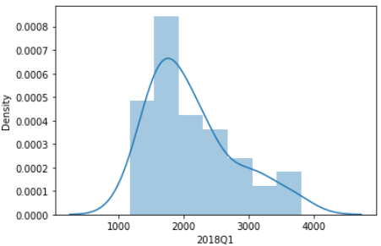
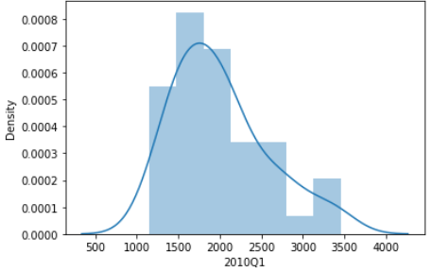
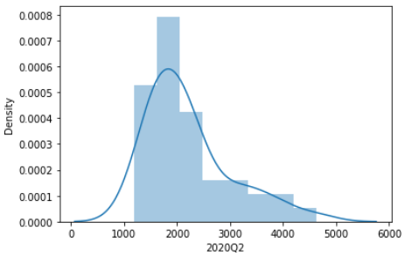
Terraced houses EDA

Slide 3
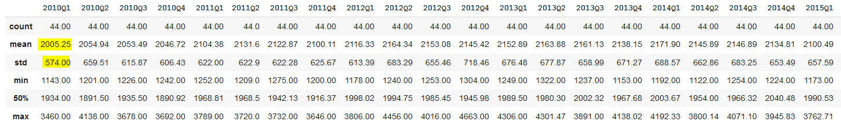

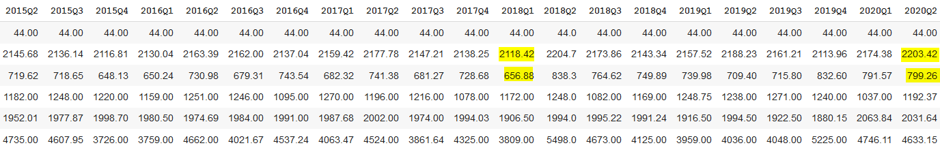
Terraced houses EDA
Mean diff btw 2010 Q1 & 2020Q2 = 198,17
Std diff btw 2010 Q1 & 2020Q2 = 225,26

Slide 4
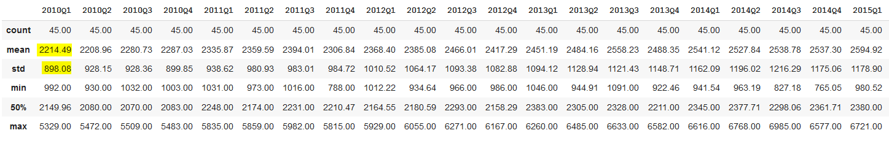
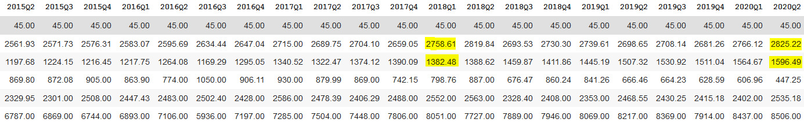
One-room flat EDA
Mean diff btw 2010 Q1 & 2020Q2 = 610,73
Std diff btw 2010 Q1 & 2020Q2 = 698,41

Slide 5
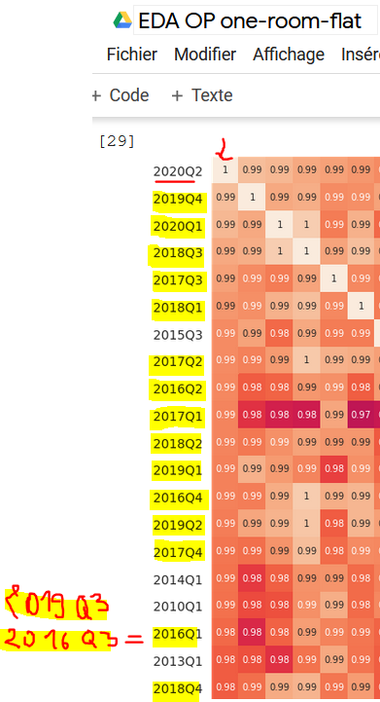
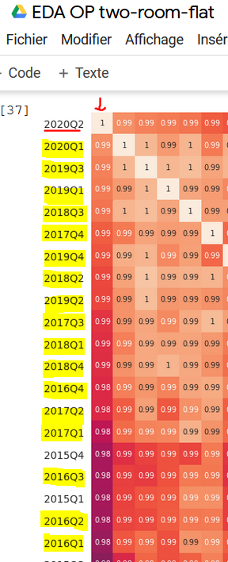
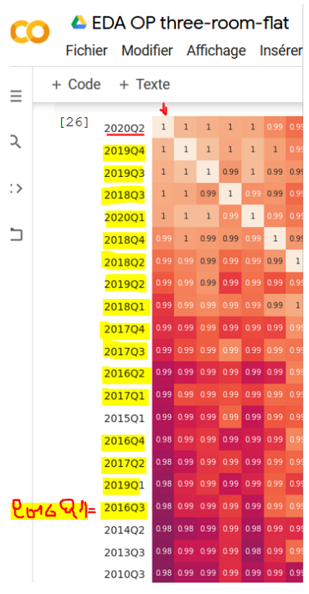
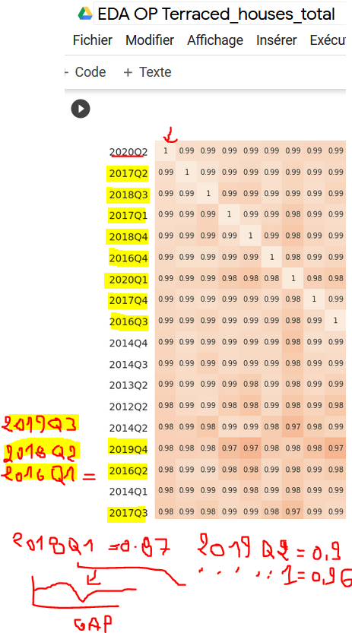
Correlations

Slide 6
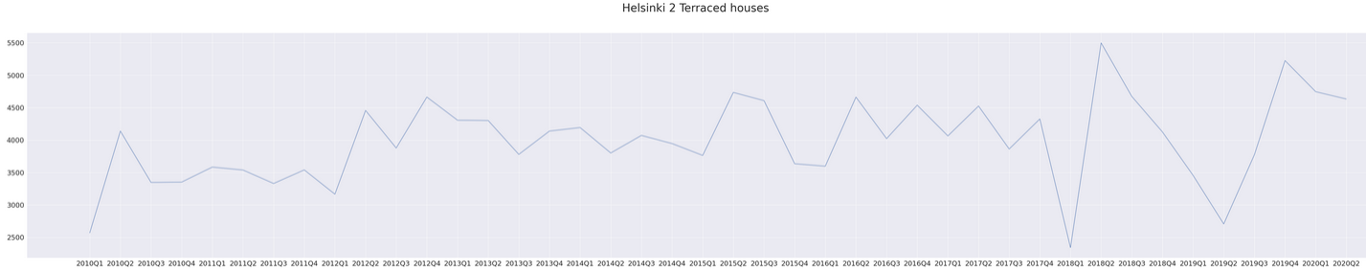
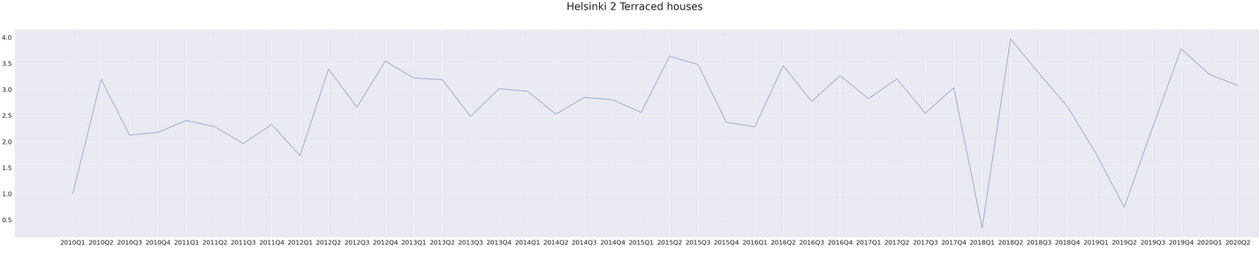
Terraced houses EDA

Slide 7
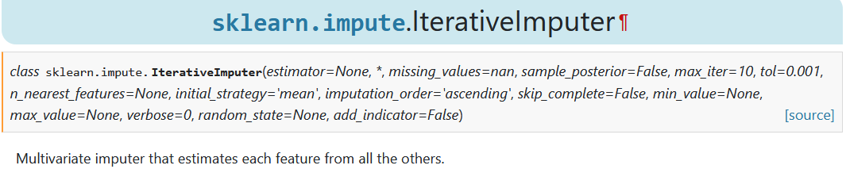
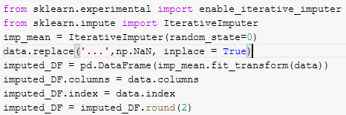
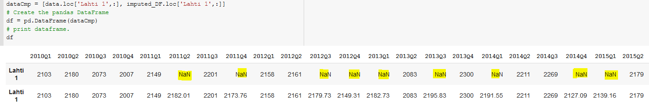
Terraced houses EDA

Slide 8
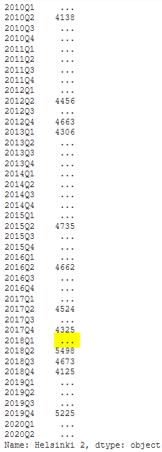
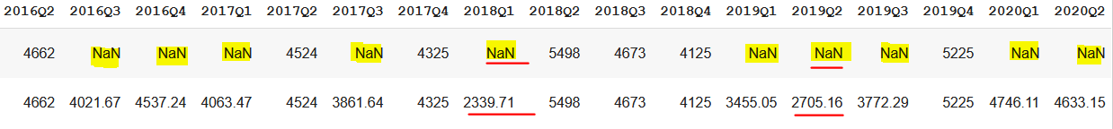
Terraced houses EDA

Slide 9

Statistics in one-room flats
Regions that have less than 50% data
Regions that have less than 40% data
Percentage of missing data, after cutting regions with more than 70% of missing data = 11,08
Regions that have less than 30% data:
Regions that have less than 20% data:

Slide 10
Optimal start year
10 years before 2021 ?
4 years before 2021 ?
n years before 2021 ?
2 years before 2021 ?
Since which year (optimal year) must our model train to give us the highest precision ?
Create separate models for each region based on the optimal year for each.
Should we find the optimal year for each region ?
Create a single model for all regions based on the single optimum year.
Should we find the optimal year for just the whole dataset ?

Slide 11
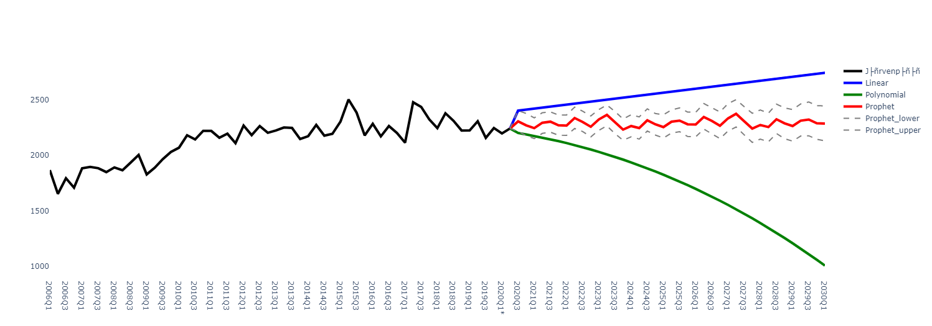
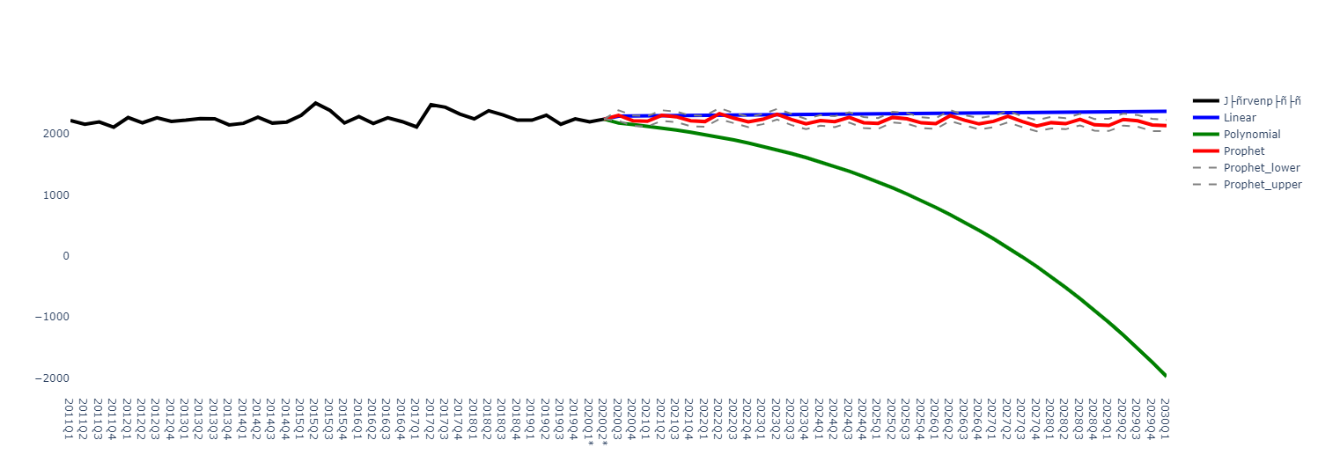
Some test prediction with different start year
Järvenpää since 2006 (whole dataset)
Järvenpää since 2011

Slide 12
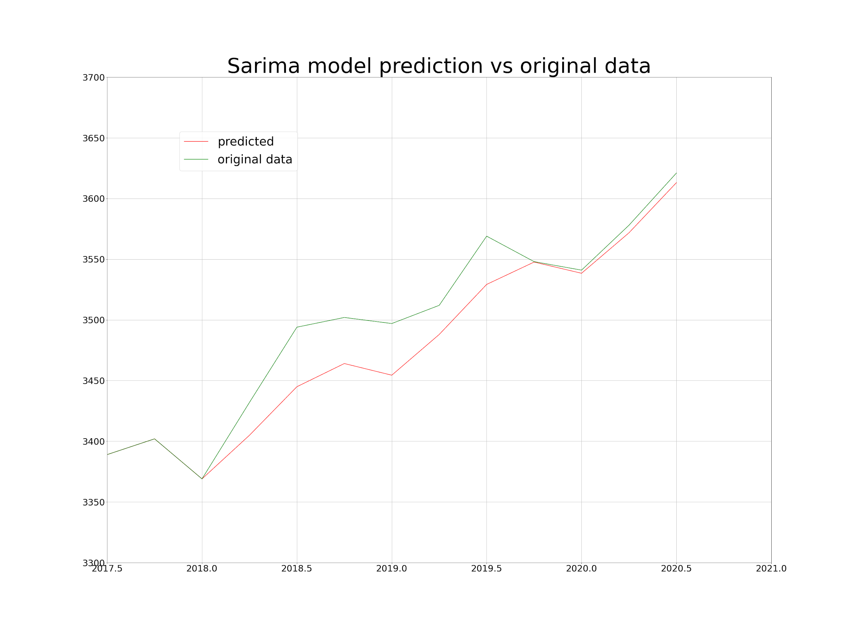
Applying SARIMA model
The model is applied on the data from 2006Q1 until 2017Q4 and making predictions on the data from 2018Q1 to 2020Q2.
The prediction gives a mean squared error of 865.96 and a mean absolute error of 23.75.

Slide 13
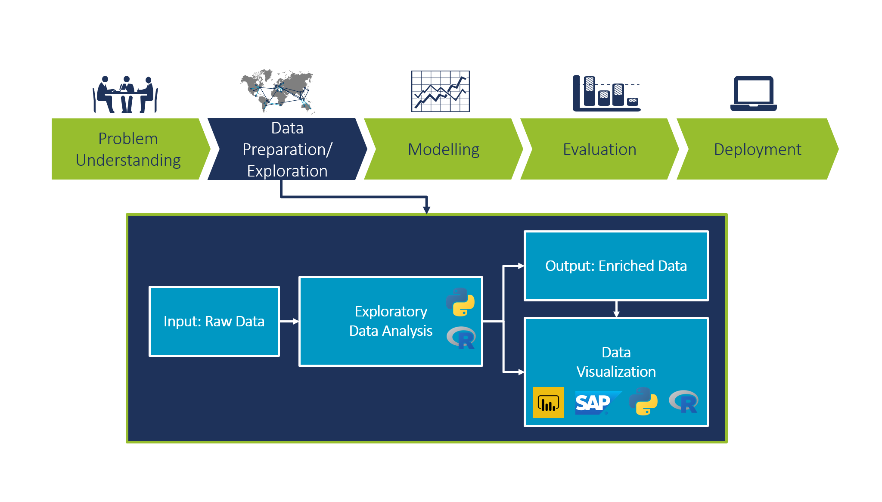
Where we are now:

Slide 14

Next steps
Prepare final data with precise imputations.
Based on the MSE and especially the MAE: choose whether we need to find the optimal year for each region or for all regions.
Start writing the report.

Slide 15

Thank you for your kind attention ☺

